Slide 1

Introduction to Machine Learning
Presented by:
Elizer Ponio Jr.
Department of Computer Science
College of Computing and Information Technologies

Slide 2

Notes:
Have you asked yourself the question, why do people organize?
Lets go to the psychology of organizing
This predictability applies within the context of our homes, manifesting through the concept of organization

Slide 3

Notes:
Have you asked yourself the question, why do people organize?
Lets go to the psychology of organizing
This predictability applies within the context of our homes, manifesting through the concept of organization

Slide 4
Outline
Applications of Machine Learning
What is Machine Learning?
The Machine Learning Paradigm
Notes:
Have you asked yourself the question, why do people organize?
Lets go to the psychology of organizing
This predictability applies within the context of our homes, manifesting through the concept of organization

Slide 5

Applications of Machine Learning
Social Media Features
Facebook notices and records your activities, chats, likes, and comments, and the time you spend on specific kinds of posts. Machine learning learns from your own experience and makes friends and page suggestions for your profile.
Notes:
Have you asked yourself the question, why do people organize?
Lets go to the psychology of organizing
This predictability applies within the context of our homes, manifesting through the concept of organization

Slide 6


Applications of Machine Learning
2. Product Recommendation
Product recommendation is one of the stark features of almost every e-commerce website today, which is an advanced application of machine learning techniques. Using machine learning, websites track your behavior based on your previous purchases, searching patterns, and cart history, and then make product recommendations.
Notes:
Have you asked yourself the question, why do people organize?
Lets go to the psychology of organizing
This predictability applies within the context of our homes, manifesting through the concept of organization

Slide 7
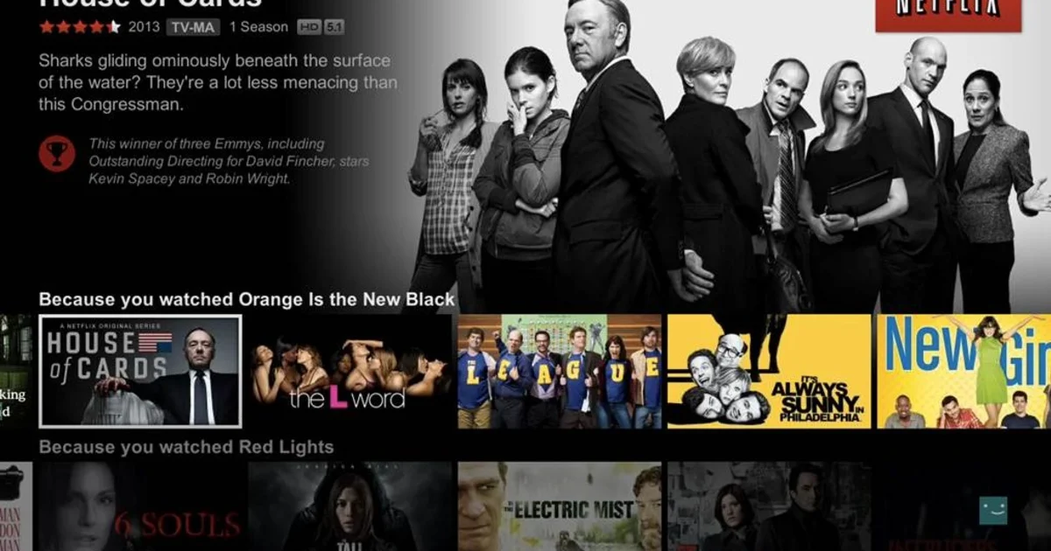
Applications of Machine Learning
3. Video Recommendation
Video recommendation is also one of the features of video sharing websites which is using machine learning techniques. Using machine learning, websites track your behavior based on your previous videos watched, searching patterns history, and then make suggested video recommendations.
Notes:
Have you asked yourself the question, why do people organize?
Lets go to the psychology of organizing
This predictability applies within the context of our homes, manifesting through the concept of organization

Slide 8
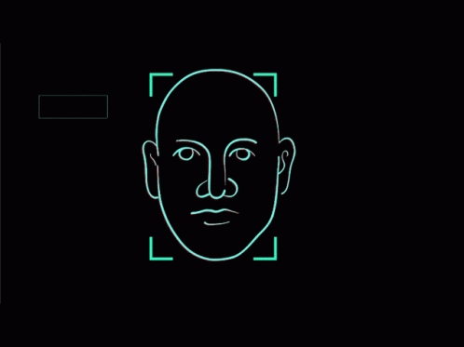

Applications of Machine Learning
4. Image recognition
An approach for cataloging and detecting a feature or an object in the digital image, is one of the most significant and notable machine learning techniques. This technique is being adopted for further analysis, such as pattern recognition, face detection, object detection and face recognition.
Notes:
Have you asked yourself the question, why do people organize?
Lets go to the psychology of organizing
This predictability applies within the context of our homes, manifesting through the concept of organization

Slide 9

Applications of Machine Learning
5. Language Translation
One of the most common machine learning applications is language translation. The technology behind the translation tool is called machine translation.
Notes:
Have you asked yourself the question, why do people organize?
Lets go to the psychology of organizing
This predictability applies within the context of our homes, manifesting through the concept of organization

Slide 10
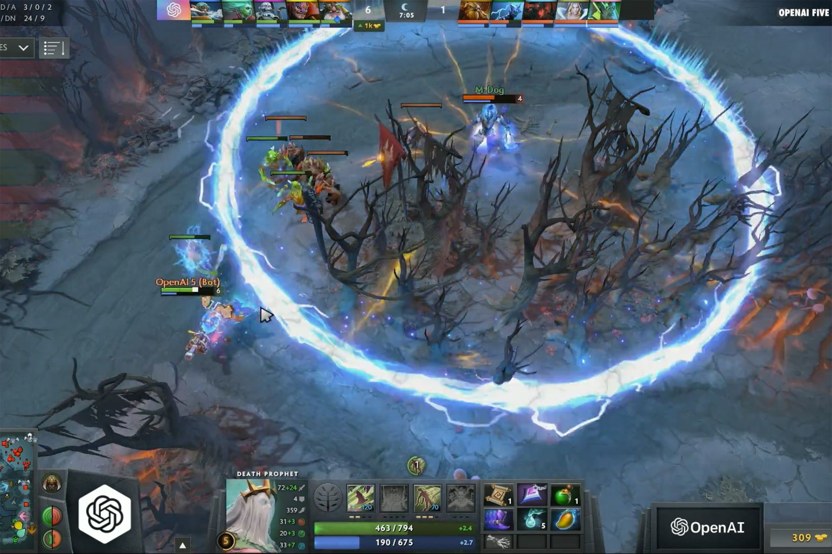
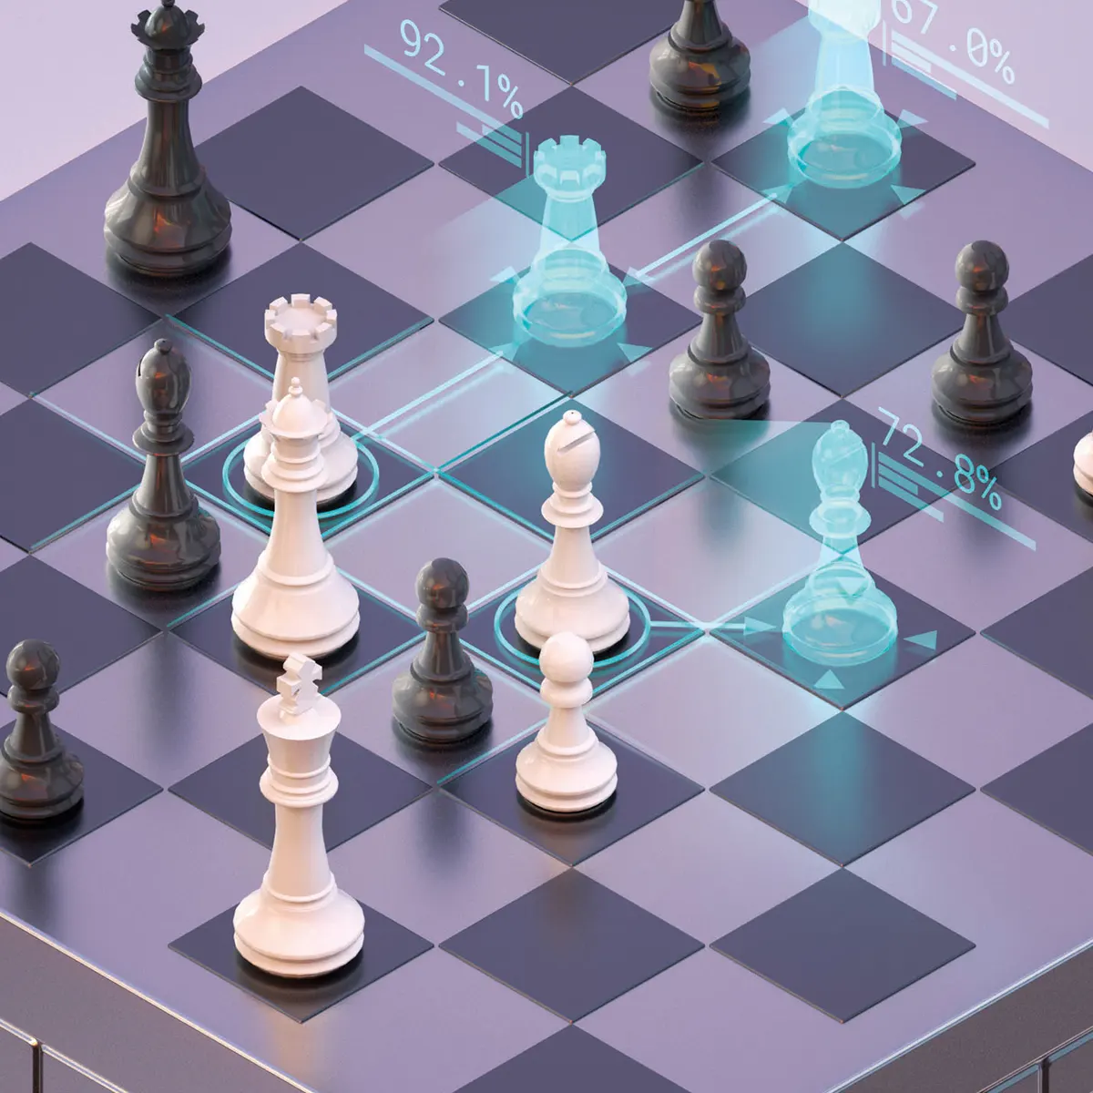
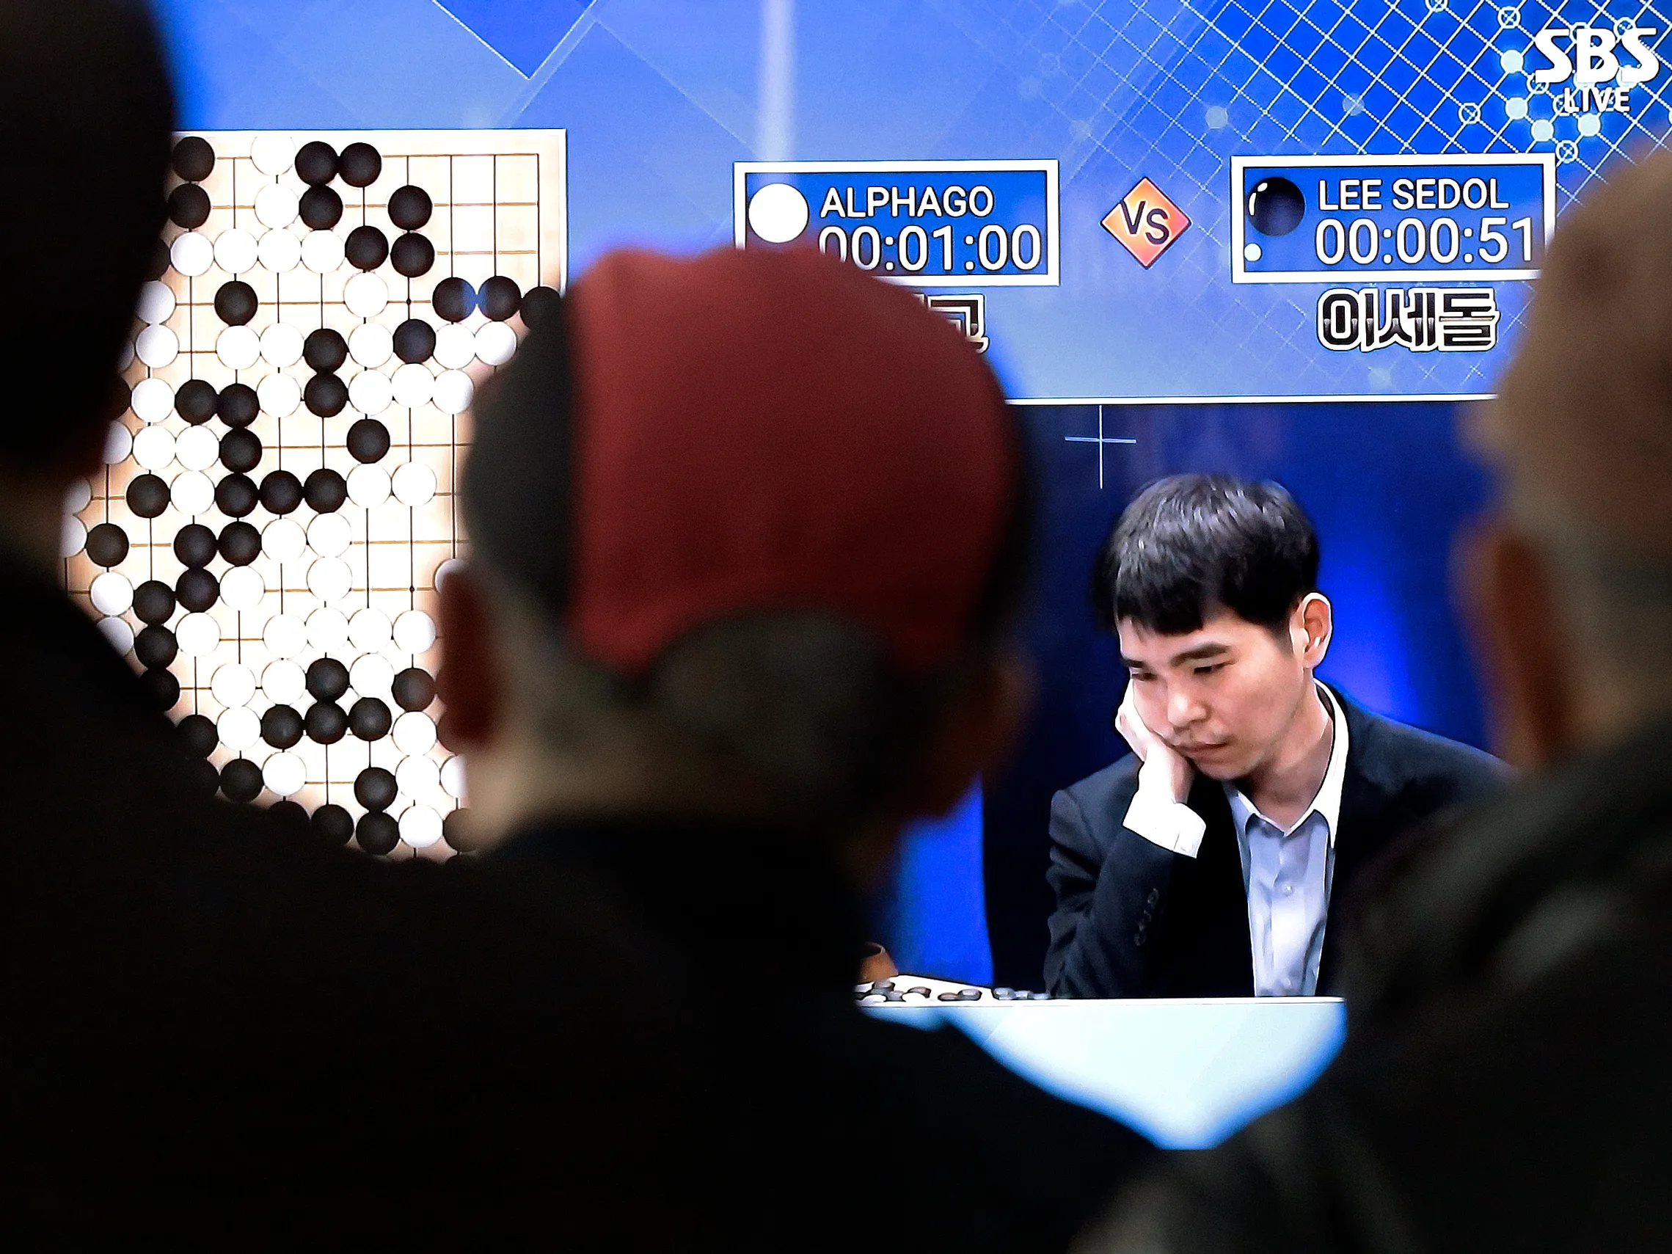
Applications of Machine Learning
5. AI Players
Machine learning led to the creation of powerful programs such as Open AI Five, AlphaZero, AlphaGo. They have achieved superhuman performance and have become invaluable tools for analyzing and learning from games.
Notes:
Have you asked yourself the question, why do people organize?
Lets go to the psychology of organizing
This predictability applies within the context of our homes, manifesting through the concept of organization

Slide 11
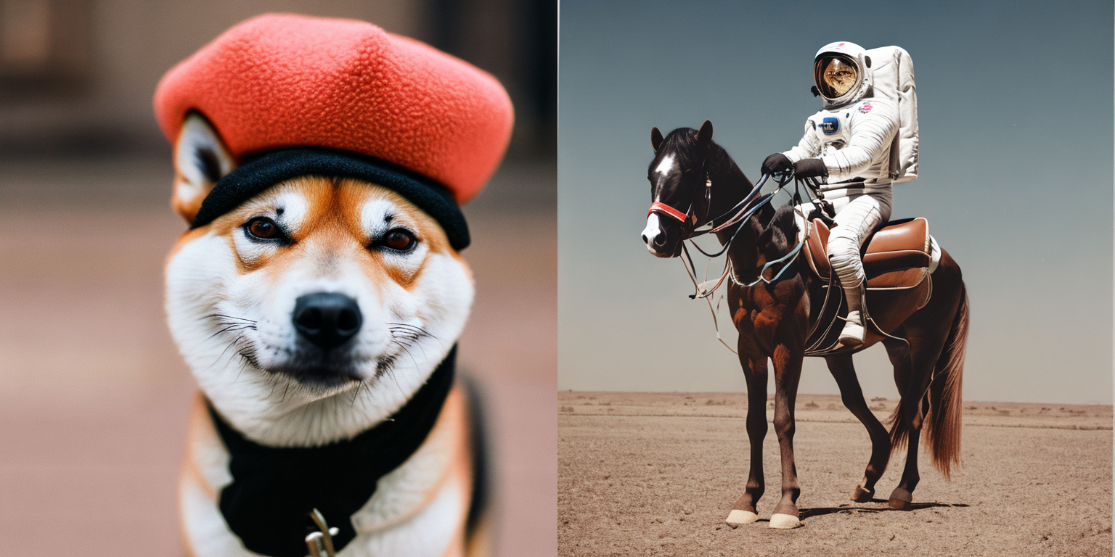
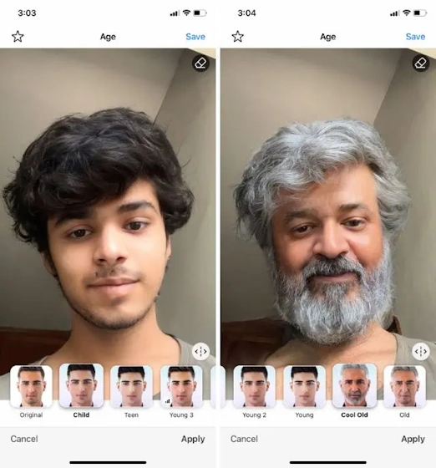

Applications of Machine Learning
5. Synthesizing and Generating videos and images
Notes:
Have you asked yourself the question, why do people organize?
Lets go to the psychology of organizing
This predictability applies within the context of our homes, manifesting through the concept of organization

Slide 12


Applications of Machine Learning
And many more!
Notes:
Have you asked yourself the question, why do people organize?
Lets go to the psychology of organizing
This predictability applies within the context of our homes, manifesting through the concept of organization

Slide 13

Applications of Machine Learning
What is Machine Learning?
The Machine Learning Paradigm
Notes:
Have you asked yourself the question, why do people organize?
Lets go to the psychology of organizing
This predictability applies within the context of our homes, manifesting through the concept of organization

Slide 14
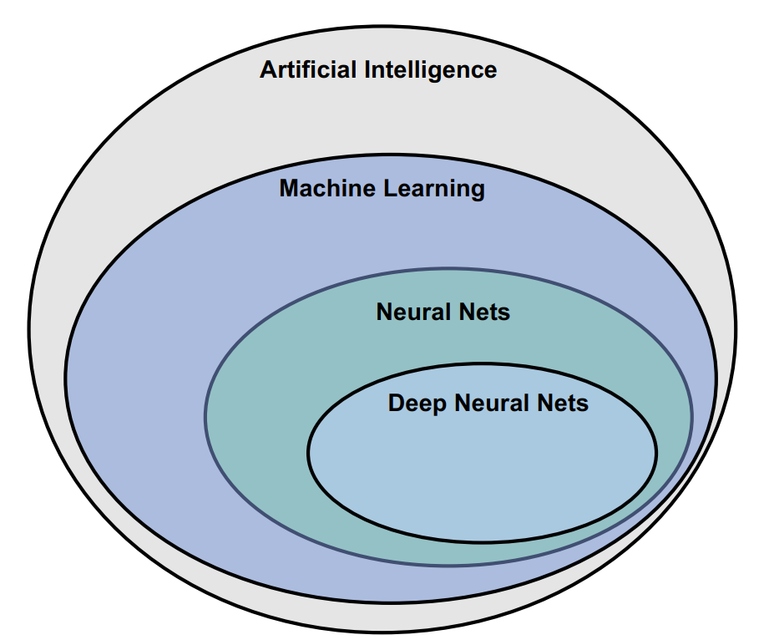
What is Machine Learning?
Artificial Intelligence (AI) refers to the
simulation of human intelligence
in machines or any technique that enables computers to mimic human behavior.
One of those techniques is Machine Learning!
Notes:
Have you asked yourself the question, why do people organize?
Lets go to the psychology of organizing
This predictability applies within the context of our homes, manifesting through the concept of organization

Slide 15
What is Machine Learning?
In order to understand what machine learning is, we need to learn how to think like one!
Notes:
Have you asked yourself the question, why do people organize?
Lets go to the psychology of organizing
This predictability applies within the context of our homes, manifesting through the concept of organization

Slide 16
What is Machine Learning?
Input: | 1 | 2 | 3 | 4
Output: | 2 | 4 | 6 | 8
Notes:
Have you asked yourself the question, why do people organize?
Lets go to the psychology of organizing
This predictability applies within the context of our homes, manifesting through the concept of organization

Slide 17
What is Machine Learning?
Input: | 1 | 2 | 3 | 4 | 5
Output: | 2 | 4 | 6 | 8 | ???
Question: What will be the output value if we have an input value of 5?
Notes:
Have you asked yourself the question, why do people organize?
Lets go to the psychology of organizing
This predictability applies within the context of our homes, manifesting through the concept of organization

Slide 18
What is Machine Learning?
Input: | 1 | 2 | 3 | 4 | 5
Output: | 2 | 4 | 6 | 8 | 10
Formula:
Output = Input * 2
f(x) = x * 2
Notes:
Have you asked yourself the question, why do people organize?
Lets go to the psychology of organizing
This predictability applies within the context of our homes, manifesting through the concept of organization

Slide 19
What is Machine Learning?
Input: | 0 | 8 | 15 | 22
Output: | 32 | 46.4 | 59 | 71.6
Notes:
Have you asked yourself the question, why do people organize?
Lets go to the psychology of organizing
This predictability applies within the context of our homes, manifesting through the concept of organization

Slide 20
What is Machine Learning?
Input: | 0 | 8 | 15 | 22 | 38
Output: | 32 | 46.4 | 59 | 71.6 | ???
Question: What will be the output value if we have an input value of 38?
Notes:
Have you asked yourself the question, why do people organize?
Lets go to the psychology of organizing
This predictability applies within the context of our homes, manifesting through the concept of organization

Slide 21
What is Machine Learning?
Celsius: | 0 | 8 | 15 | 22 | 38
Fahrenheit: | 32 | 46.4 | 59 | 71.6 | 100.4
Formula:
F = C * 1.8 + 32
F = Fahrenheit
C = Celsius
f(x) = x * 1.8 + 32
Notes:
Have you asked yourself the question, why do people organize?
Lets go to the psychology of organizing
This predictability applies within the context of our homes, manifesting through the concept of organization

Slide 22

What is Machine Learning?
What you just did to figure out the relation between inputs and outputs is exactly what machine learning does!
Notes:
Have you asked yourself the question, why do people organize?
Lets go to the psychology of organizing
This predictability applies within the context of our homes, manifesting through the concept of organization

Slide 23
What is Machine Learning?
Given a set of inputs and their corresponding outputs, the goal in machine learning is to figure out the algorithm to convert the inputs to the outputs!
We learn through data!
Notes:
Have you asked yourself the question, why do people organize?
Lets go to the psychology of organizing
This predictability applies within the context of our homes, manifesting through the concept of organization

Slide 24
Applications of Machine Learning
What is Machine Learning?
The Machine Learning Paradigm
Notes:
Have you asked yourself the question, why do people organize?
Lets go to the psychology of organizing
This predictability applies within the context of our homes, manifesting through the concept of organization

Slide 25

Traditional Programming Paradigm
Algorithm
Traditional Programming
Output
Input
The input and algorithm is known and you write a function to produce an output
Notes:
Have you asked yourself the question, why do people organize?
Lets go to the psychology of organizing
This predictability applies within the context of our homes, manifesting through the concept of organization

Slide 26
Machine Learning Paradigm
Input
Machine Learning
Algorithm
Output
You know the input and the output but you do not know the algorithm that creates the output given the input
Notes:
Have you asked yourself the question, why do people organize?
Lets go to the psychology of organizing
This predictability applies within the context of our homes, manifesting through the concept of organization

Slide 27
Traditional Programming vs Machine Learning
Algorithm
Traditional Programming
Output
Input
Input
Machine Learning
Algorithm
Output
Notes:
Have you asked yourself the question, why do people organize?
Lets go to the psychology of organizing
This predictability applies within the context of our homes, manifesting through the concept of organization

Slide 28
Traditional Programming vs Machine Learning
There are tasks such as Language Translation and Understanding that cannot be solved using traditional programming.
Notes:
Have you asked yourself the question, why do people organize?
Lets go to the psychology of organizing
This predictability applies within the context of our homes, manifesting through the concept of organization

Slide 29
Traditional Programming vs Machine Learning
def translate_to_english (word):
if word == “House”:
translated = “Bahay”
elif
...
...
return translated
Notes:
Have you asked yourself the question, why do people organize?
Lets go to the psychology of organizing
This predictability applies within the context of our homes, manifesting through the concept of organization

Slide 30
Traditional Programming Approach
Input
def function (Celsius):
Fahrenheit = Celsius * 1.8 + 32
return Fahrenheit
Algorithm
Output
Notes:
Have you asked yourself the question, why do people organize?
Lets go to the psychology of organizing
This predictability applies within the context of our homes, manifesting through the concept of organization

Slide 31

Machine Learning Approach
Input
def function (Celsius):
return Fahrenheit
Algorithm
Output
Notes:
Have you asked yourself the question, why do people organize?
Lets go to the psychology of organizing
This predictability applies within the context of our homes, manifesting through the concept of organization

Slide 32
Machine Learning Approach
def function (Celsius):
return Fahrenheit
Input
Neural Network
Algorithm
Output
Notes:
Have you asked yourself the question, why do people organize?
Lets go to the psychology of organizing
This predictability applies within the context of our homes, manifesting through the concept of organization

Slide 33
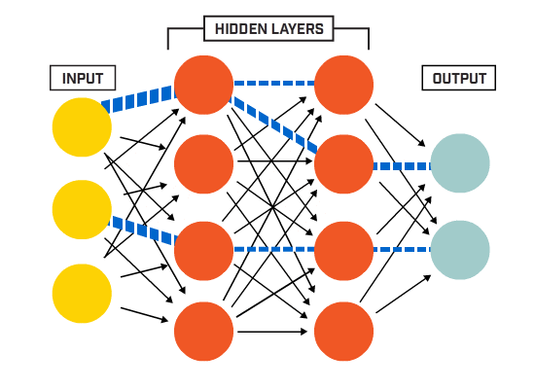
Machine Learning Approach
Machine Learning Algorithm
A machine learning approach consists of using machine learning algorithm like a neural network to learn the relations between the inputs and the outputs, thus learning the algorithm
Notes:
Have you asked yourself the question, why do people organize?
Lets go to the psychology of organizing
This predictability applies within the context of our homes, manifesting through the concept of organization

Slide 34
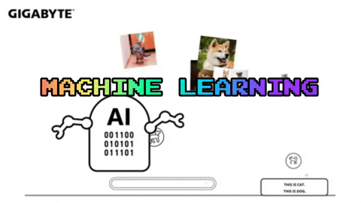
Machine Learning Approach
In order for a machine learning algorithm to learn the correct relationship between the inputs the and outputs, we have to train it!
Notes:
Have you asked yourself the question, why do people organize?
Lets go to the psychology of organizing
This predictability applies within the context of our homes, manifesting through the concept of organization

Slide 35
Machine Learning Approach
We train our machine learning algorithm by letting it try to map the inputs to the outputs.
Input: | 0 | 8 | 15 | 22 | 38
Output: | 32 | 46.4 | 59 | 71.6 | 100.4
Notes:
Have you asked yourself the question, why do people organize?
Lets go to the psychology of organizing
This predictability applies within the context of our homes, manifesting through the concept of organization

Slide 36

Machine Learning Approach
def function (Celsius):
return Fahrenheit
Neural Network
Input: | 0 | 8 | 15 | 22 | 38
Output: | 32 | 46.4 | 59 | 71.6 | 100.4
Notes:
Have you asked yourself the question, why do people organize?
Lets go to the psychology of organizing
This predictability applies within the context of our homes, manifesting through the concept of organization

Slide 37
Machine Learning Approach
Machine Learning Algorithm
In very simple terms, you can think of a machine learning algorithm (e.g., neural networks) as a function that can tune its variables in order to correctly map its inputs to some outputs.
Notes:
Have you asked yourself the question, why do people organize?
Lets go to the psychology of organizing
This predictability applies within the context of our homes, manifesting through the concept of organization

Slide 38
Machine Learning Approach
Machine Learning Algorithm
As we will see, the training process to teach our machine learning algorithm (e.g., neural network) to tune its internal variables is performed for thousand or even millions of iterations over the input and output data!
Notes:
Have you asked yourself the question, why do people organize?
Lets go to the psychology of organizing
This predictability applies within the context of our homes, manifesting through the concept of organization

